Slide 1
PCR Troubleshooting
Virginia Balke
Delaware Technical Community College
CCURI Lab Methods Workshop
Tulsa Community College
July 2015

Slide 2
Day 1
Thursday, July 9

Slide 3
Reaction Components
Template – Target DNA
Taq Polymerase
Buffer (2x, 5x, 10x)
Magnesium chloride
dNTPs
Primers – Forward and Reverse
0.1 to 0.5 μM

Slide 4
Template
Quantity and Quality
Quantity depends on type
Plasmid 1 pg to 1 ng
Genomic 1 ng to 1 μg
Quality depends on source
Avoid freeze/thaw
Keep on ice

Slide 5
Taq Polymerases
Standard
No 3’→ 5’ exonuclease proofreading
3’ A for Topo TA cloning
1/1,000 to 1/10,000 error rate
Hot Start
Modifications that inhibit activity until heating
Antibodies, covalent modifications, aptamers

Slide 6
Taq Polymerases
High Fidelity
3’→ 5’ exonuclease proofreading
Blunt ends
1/100,000 to 1/1,000,000 error rate
Rapid Cycling
Steps are shortened to 5 to 10 seconds

Slide 7
Magnesium Chloride
Cofactor for enzymes
Stabilizes DNA and dNTPs
Increasing MgCl₂, increases Tm
Most PCR Master Mixes contain 1.5 mM MgCl₂
Can be optimized

Slide 8
Different Types of Kits
Each component is separate
2x or 10x Master Mixes
Components to increase specificity
Loading dye

Slide 9
Designing Cycling Conditions
Initial denaturation
95°C for 2 – 5 minutes
Denaturation
95°C for 30 seconds
Annealing
2 – 5 degrees below lowest primer Tm
30 – 60 seconds
Extension
72°C
Time depends on length of amplicon
1 kb for 1 minute
Repeat 30 – 35 cycles
Final extension at 72°C for 5 – 15 minutes
Hold 4 – 12°C

Slide 10
Calculating Primer Tm
2°C x (A + T) + 4°C x (G + C)

Slide 11
Day 2
Friday July 10

Slide 12
DNA Barcodes for Everyday Life
Reaction mixture
MgCl₂ concentration?
Use of multiple primers
Percentage of NS

Slide 13
Barcoding at DTCC
Microbiology
16S rRNA on cultured soil microbes
Master Mix is prepared by instructor
Biotechnology
Culture independent analysis of soil microbes
Insects as part of bat diet project
Students increasingly learn to do calculations and make own master mix

Slide 14
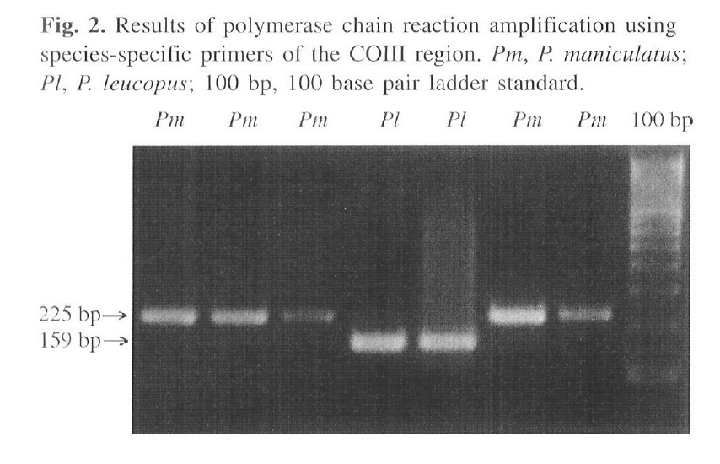
Barcoding at DTCC
Research Projects
Fern Species
Big Brown Bat diet (primer specificity issues)
Species confirmation of bats
Mouse ID

Slide 15
Mammal Barcoding
Template is mouse genomic DNA
COX primers
Forward
TCAACCAACCACAAAGACATTGGCAC Tm = 65
Reverse
TAGACTTCTGGGTGGCCAAAGAATCA Tm = 65
Amplicon size 650 bp

Slide 16
Optimizing Reaction Conditions
Template Concentration
Primer Concentration
MgCl₂ Concentration
Temperature Gradient
Negative and Positive Control

Slide 17
PCR Setup
Three different Taq formulations
Qiagen HotStarTaq Master Mix
Qiagen TopTaq Master Mix
Qiagen TopTaq Polymerase
Three different MgCl₂ concentrations
Three different temperatures
20 μL reactions, 2 μL template
1 μL primer mix

Slide 18
Calculating MgCl₂
Master Mixes and Buffers contain 1.5 mM MgCl₂
To bring to 2.5 mM – add 1 mM MgCl₂
To bring to 4 mM – add 2.5 mM MgCl₂

Slide 19
Cycling Conditions
95°C 5 minutes
35x
95°C for 1 min
43, 52, or 58°C 30 sec
72°C 30sec
72°C 15 minutes
12°C Hold

Slide 20
Primer Design
18 – 30 bases in length
40 – 60% GC content
Aim for Tm of 55 to 70°C
Tm of pair should be similar
Have C or A at 3’ terminal (they do not wobble)
Avoid runs of 3 or more of the same base
Avoid complementarity between the two primers
Avoid hairpins internally
Avoid self-complementarity

Slide 21
Primer Design
Design primers for a gene from Sphingobacterium sp. ML3W
Use IDT to analyze primers
http://www.idtdna.com/calc/analyzer

Slide 22
Primer Design
As much as possible – make sure that your primer pair does not bind elsewhere in the genome
Use BLAST http://blast.ncbi.nlm.nih.gov/Blast.cgi to check if your primers bind to a unique site in the Sphingobacterium sp. ML3W genome
BLAST nucleotide
Align two or more sequences
Paste your primers into the first box
Paste the ML3W Accession number: CP009278.1 into the second box

