Slide 1
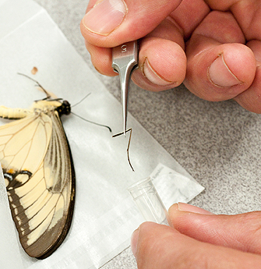
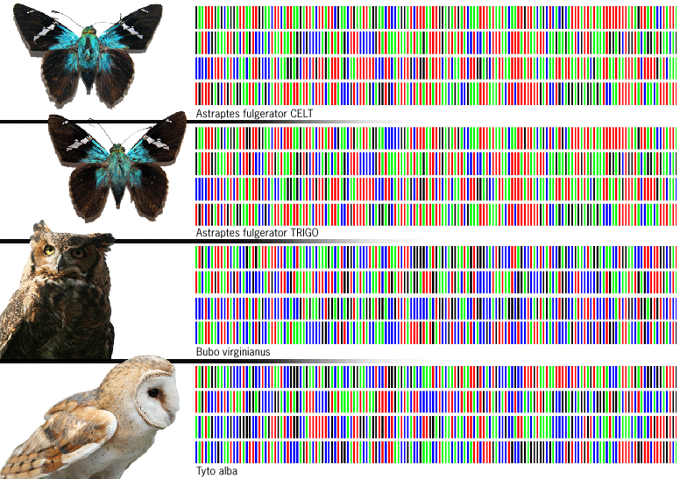
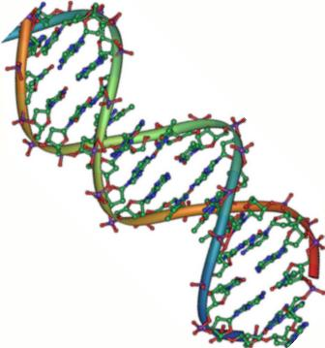
Insect DNA Barcoding

Slide 2
Agenda

Slide 3
DNA Bug Barcoding at FLCC
Finger Lakes Invertebrate Biodiversity Study (FLIBS)
Introduction to Biology (for majors), Research Methods, Genetics
Students surveys show positive
response to the lab module

Slide 4
Bug DNA Barcoding
University of California San Diego faculty developed a protocol for DNA barcoding of insects.
Addressing biodiversity questions on and around UCSD campus
Adapted protocol for community college setting

Slide 5
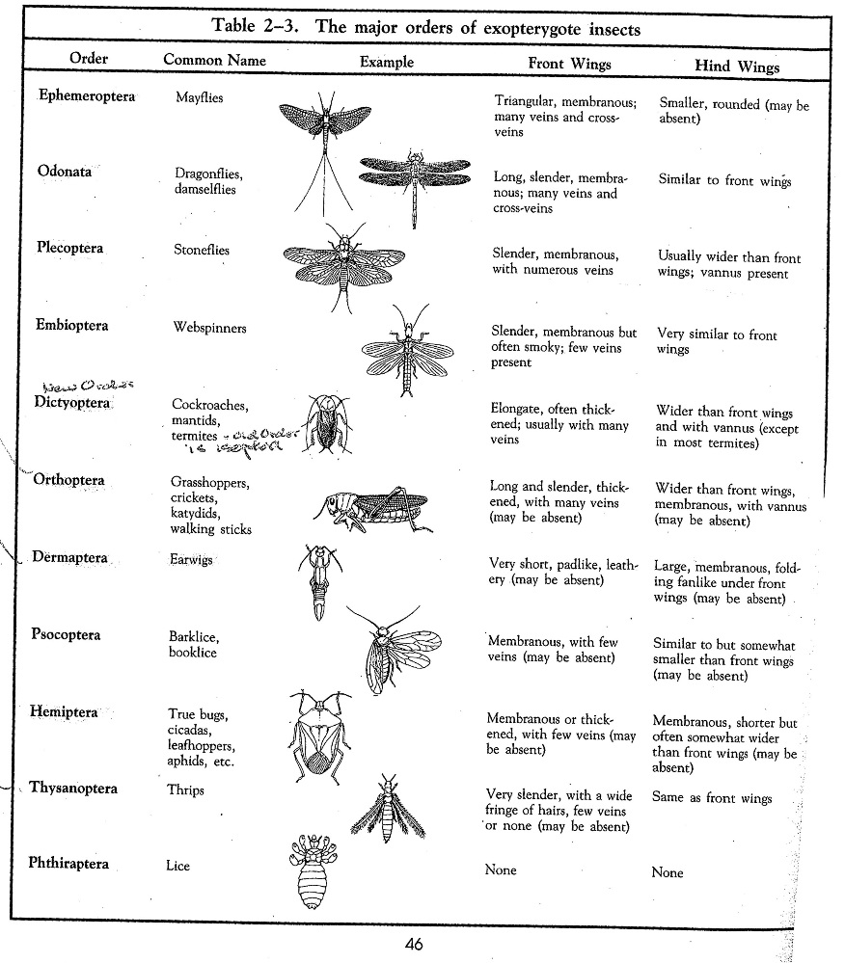
Morphology Week 1 student lab
Use morphology guide to identify bug to order
Take picture
Remove leg (3-4mm) and place in 1.5mL tube
If small bug use entire bug
Need to incubate overnight

Slide 6
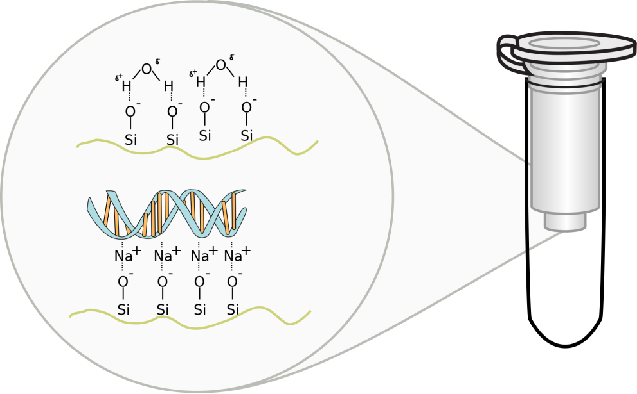
DNA Extraction Week 2 student lab
Overnight incubations were set up yesterday
Follow protocol for QIAGEN DNA Extraction kit
DNA filter column chemistry

Slide 7
Mitochondrial cytochrome c oxidase 1 gene (CO1)
648bp
Mutation rate is high, so able to distinguish between closely related species
Folmer primers – universal invertebrate barcaoding primers
Primer | Name | Sequence
Forward | LCO1490 | 5'-GGTCAACAAATCATAAAGATATTGG-3'
Reverse | HCO2198 | 5'-TAAACTTCAGGGTGACCAAAAAATCA-3'

Slide 8
PCR Reaction
Volume for one reaction (µL) | Component | Stock Concentration (µM)
25 | GoTaq green* | na
2.5 | forward primer | 10
2.5 | reverse primer | 10
17.5 | sterile water | na
*Promega Gotaq PCR Master mix – M7122

Slide 9
PCR Clean up and Gel Image Week 3 student lab
Run 5ul of PCR product on gel
Capture image on gel dock
CO1 gene is ~648bp
Purify the amplified DNA from the PCR reaction following QIAGEN kit protocol

Slide 10
Additional Resources
International Barcode of Life http://ibol.org/
Cold Springs Harbor DNA Barcoding 101 http://www.dnabarcoding101.org/
Barcode of Life http://www.barcodeoflife.org/
Insect ID website
http://www.cals.ncsu.edu/course/ent425/
http://tolweb.org/Insecta

